Slide 1

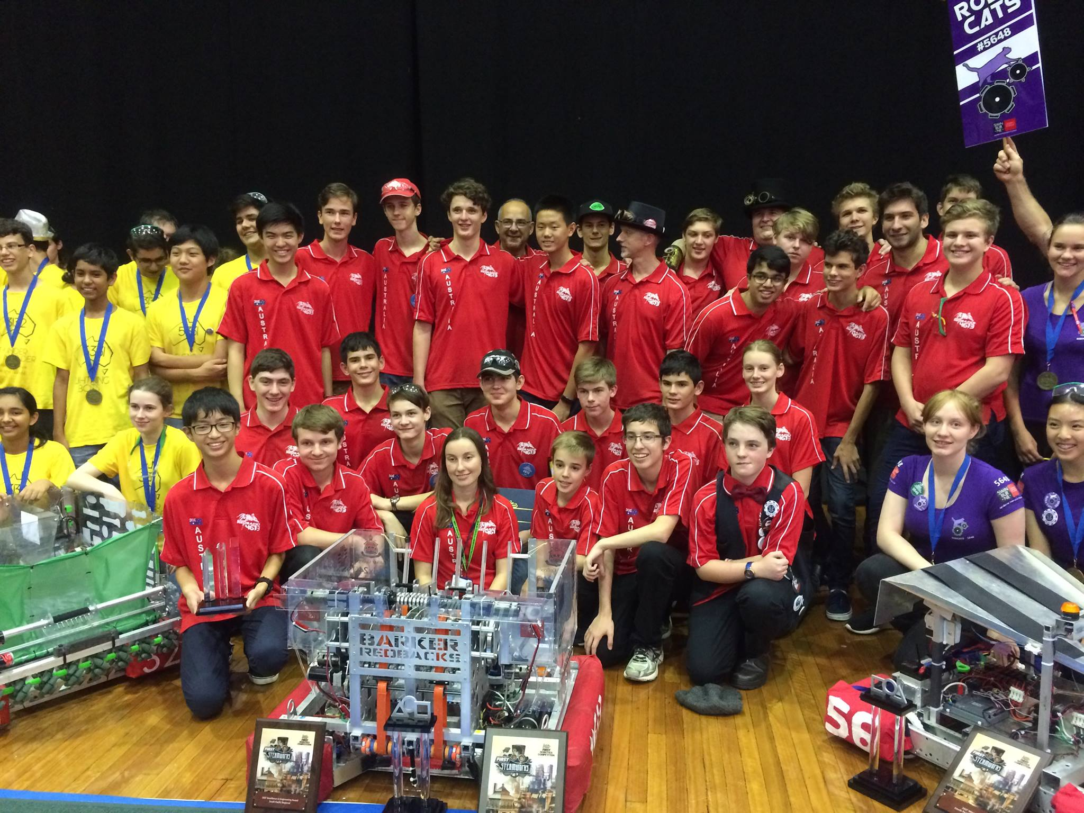
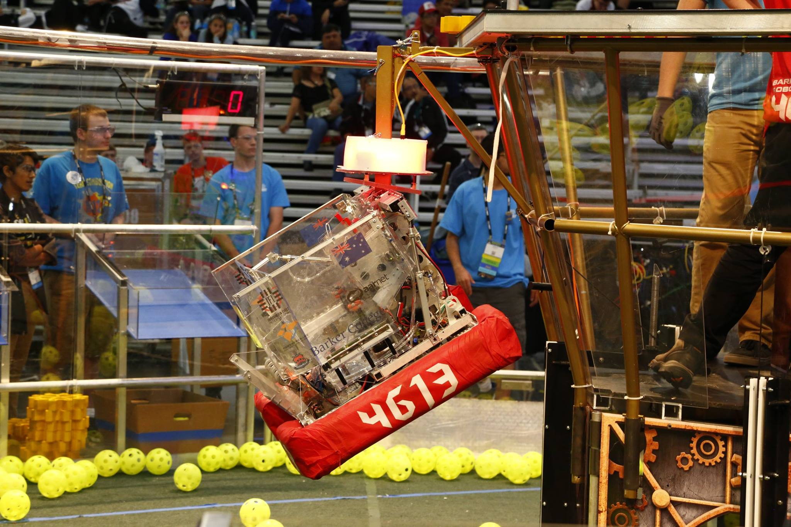
Introduction to (Java) Programming – 2.5 – Iteration
Tom Schwarz

Slide 2
Lesson 6: Iteration
Often in order to solve problems, we need to repeat things. For example, a sample algorithm to eat breakfast cereal:
Put cereal in bowl
Add milk to cereal
Spoon cereal and milk into mouth
repeat step 4 until all cereal and milk is eaten
Rinse bowl and spoon
Iteration is about how we can get computer to repeat things.
There are two ways to repeat things:
While loops – While loops loop while something is true
For loops – For loops loop for a certain amount of times

Slide 3
Lesson 6: Iteration – While Loops
While loops let you repeat something while a condition is true.
For example, the previous algorithim written as a while loop in (dodgy) pseudo java code.
Bowl bowl = new Bowl(); _ bowl.add(new Cereal()); _ bowl.add(new Milk()); _ _ while (!bowl.isEmpty()) { _ bowl.eat(); _ } _ bowl.rinse(); _
Note that the statement in beginning while loop is exactly like an if statement – you can even use and, or and not as we have

Slide 4
Lesson 6: Iteration – For loops
For loops let you do things for a set amount of times
They are quite a bit more complicated syntax wise than while loops. Eg:
for (int counter = 0; counter<=4613; counter++) { _ System.out.println(counter); _ } _

Slide 5
Lesson 6: Iteration – do while
Do while loops are like while loops, only they run once in the beginning instead.
do { _ ///Code to loop over... _ } while (condition); _

Slide 6
Lesson 6: Iteration
That’s iteration! Now take a look at the activities.
FYI there’ s activities at the bottom of While loops, and do while loops (as well as at the end)
https://github.com/Team4613-BarkerRedbacks/Programming-Java-Guide/blob/master/2.Core-elements-of-programs/2.5.Iteration.md

